Slide 1


Slide 2
Chapter 3
Data Modeling Using the Entity-Relationship Model

Slide 3
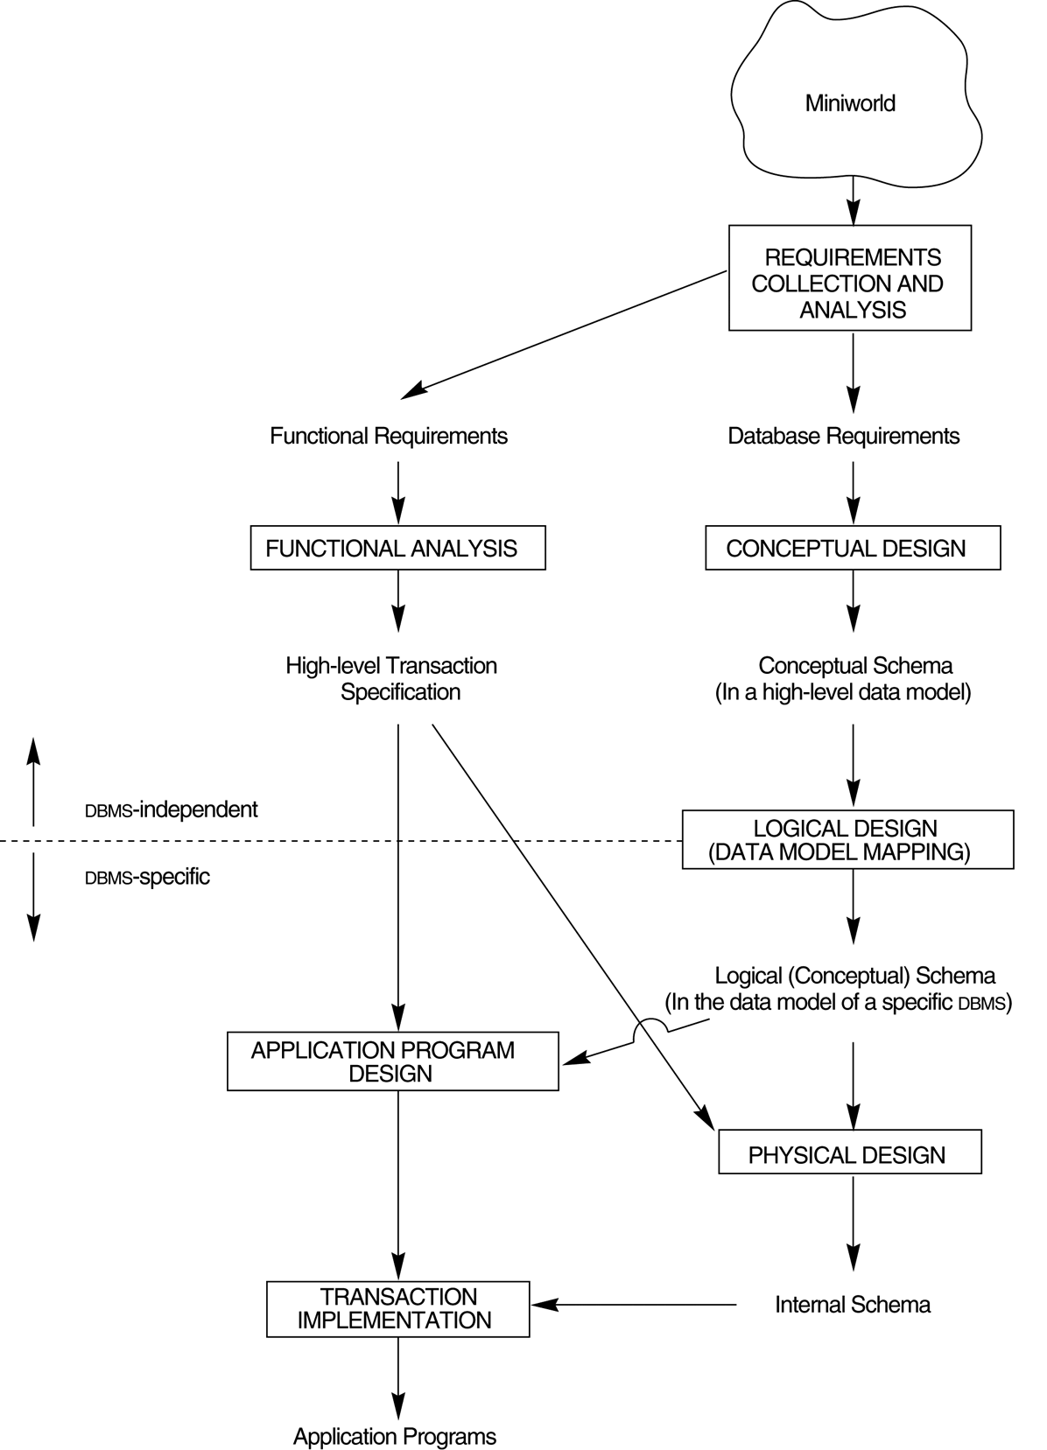
FIGURE 3.1
A simplified diagram to illustrate the main phases of database design.

Slide 4

FIGURE 3.2
An ER schema diagram for the COMPANY database.

Slide 5
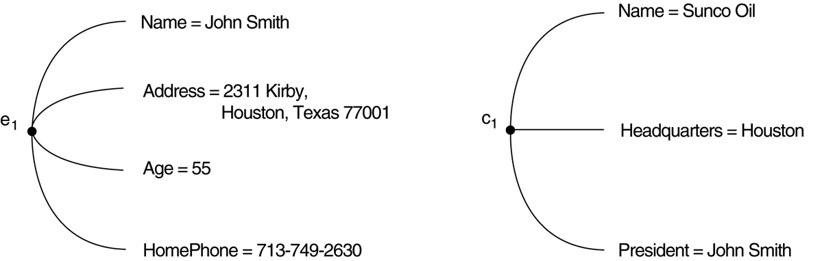
FIGURE 3.3
Two entities, employee e₁ and company c₁, and their attributes.

Slide 6
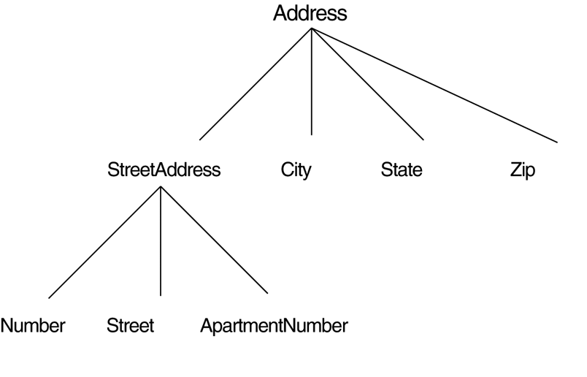
FIGURE 3.4
A hierarchy of composite attributes.

Slide 7

FIGURE 3.5
A complex attribute: AddressPhone.

Slide 8
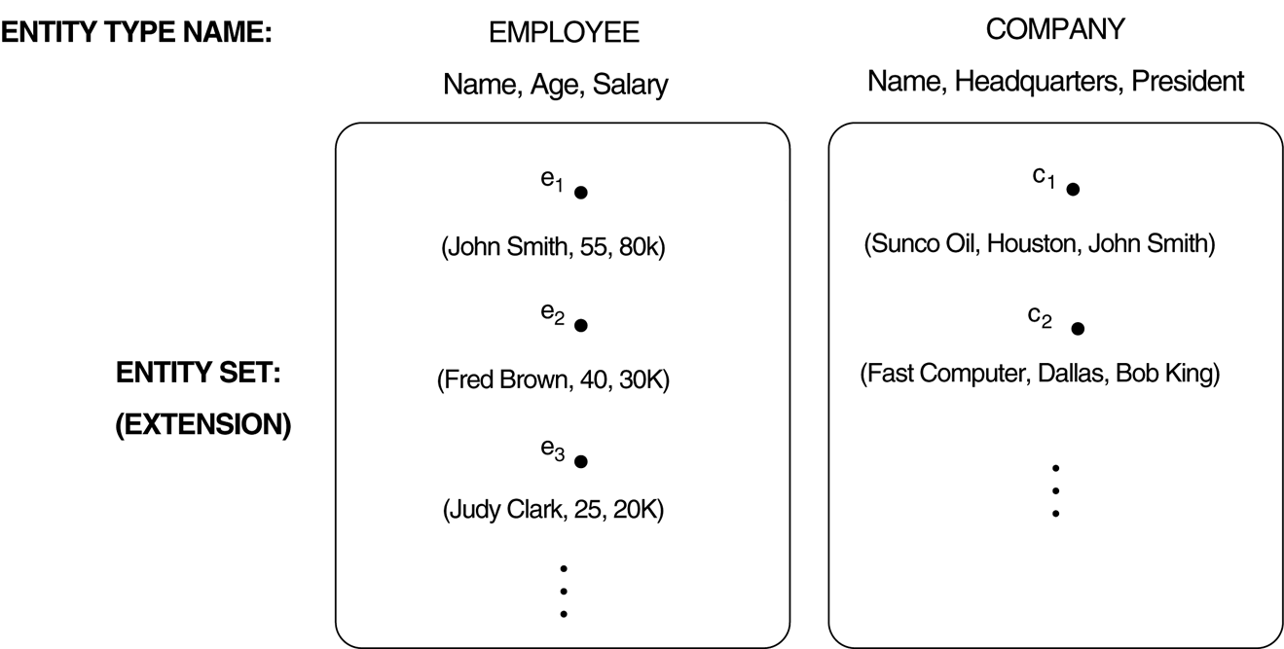
FIGURE 3.6
Two entity types, EMPLOYEE and COMPANY, and some member entities of each.

Slide 9
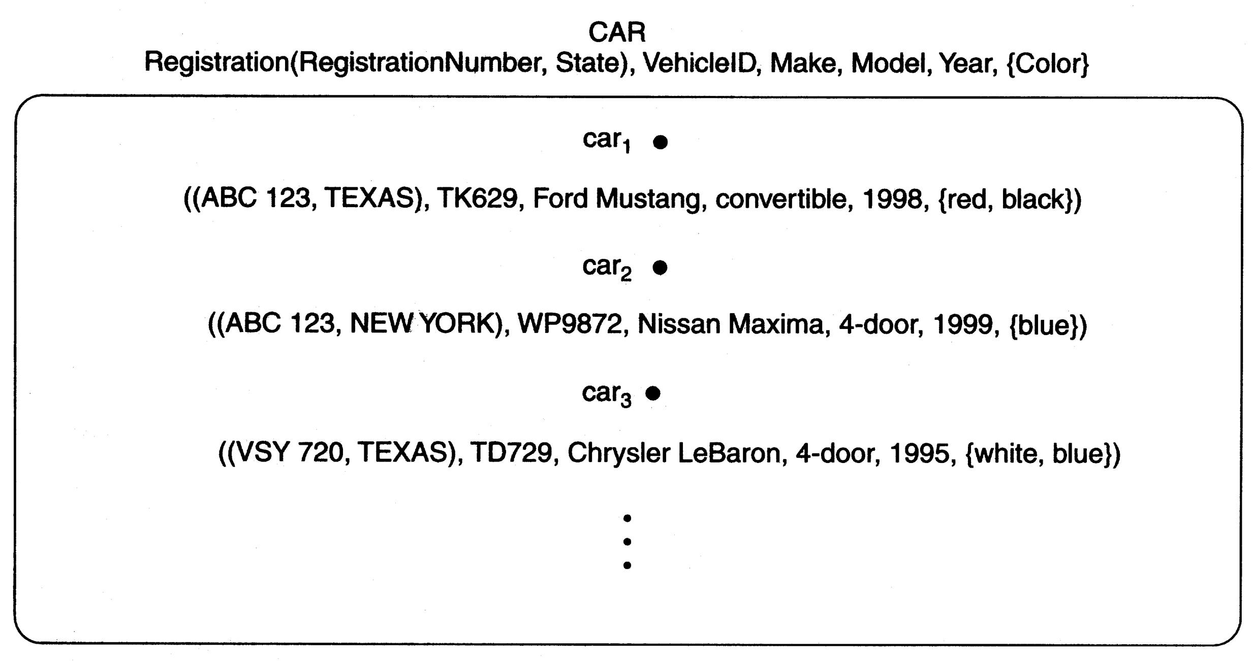
FIGURE 3.7
The CAR entity type with two key attributes, Registration and VehicleID.

Slide 10
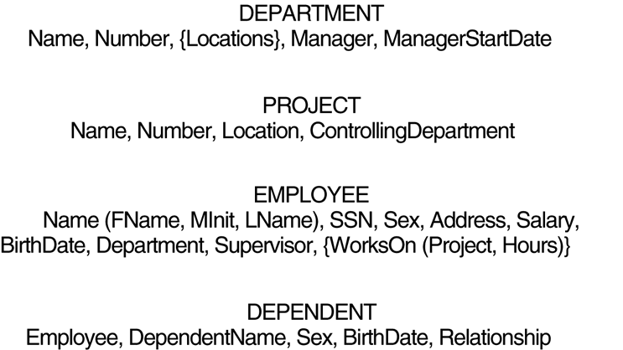
FIGURE 3.8
Preliminary design of entity types for the COMPANY database.

Slide 11
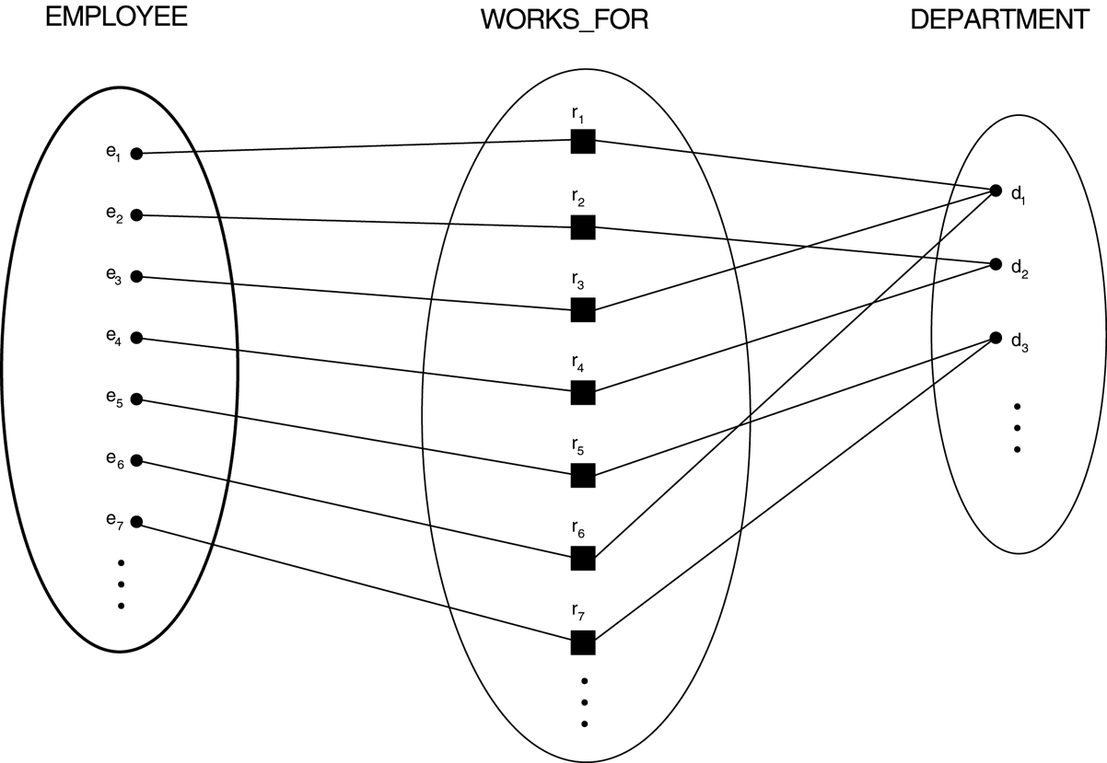
FIGURE 3.9
Some instances in the WORKS_FOR relationship set, which represents a relationship type WORKS_FOR between EMPLOYEE and DEPARTMENT.

Slide 12
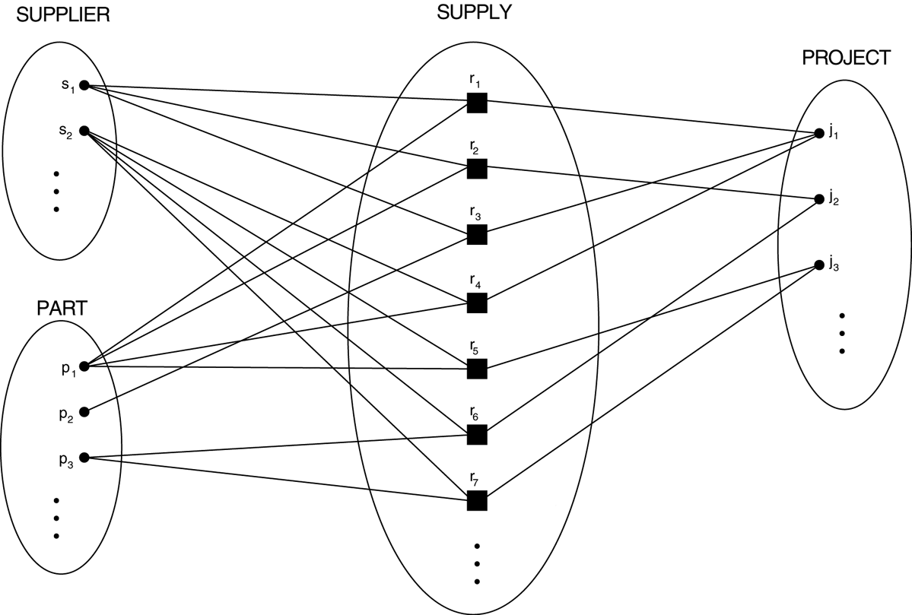
FIGURE 3.10
Some relationship instances in the SUPPLY ternary relationship set.

Slide 13
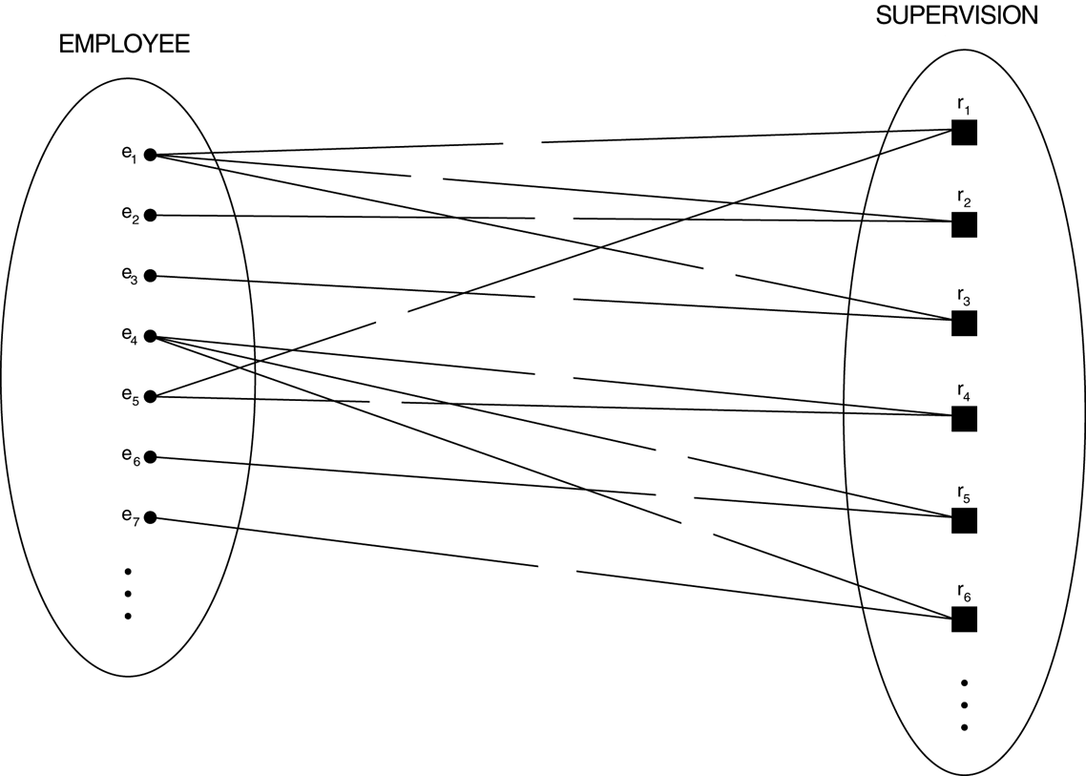
FIGURE 3.11
A recursive relationship SUPERVISION between EMPLOYEE in the supervisor role (1) and EMPLOYEE in the subordinate role (2).

Slide 14
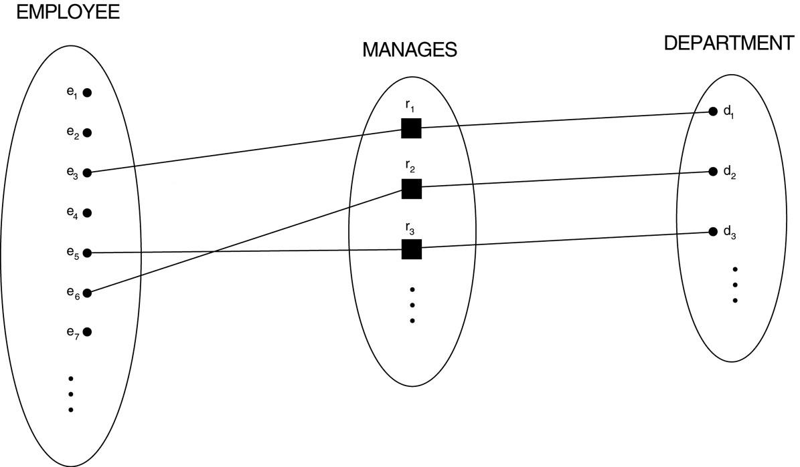
FIGURE 3.12
A 1:1 relationship, MANAGES.

Slide 15
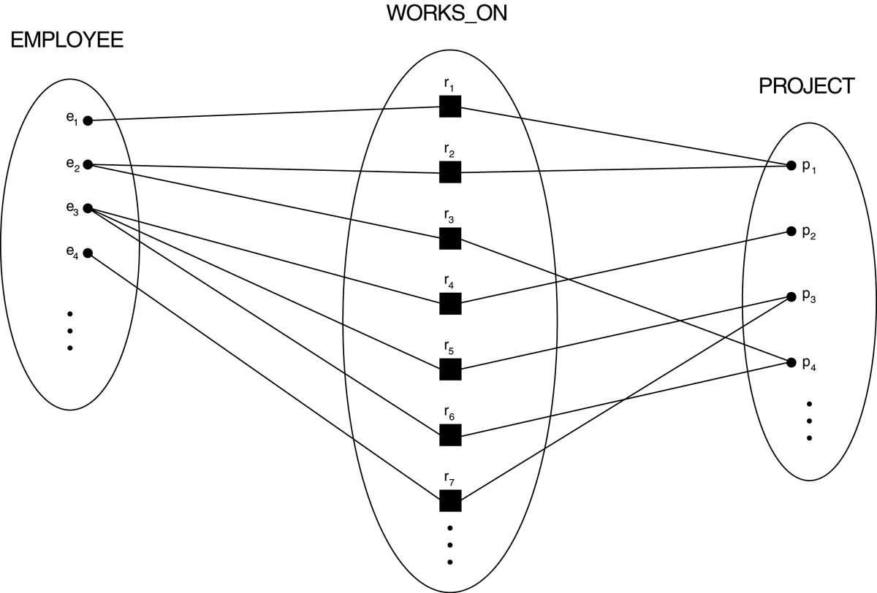
FIGURE 3.13
An M:N relationship, WORKS_ON.

Slide 16
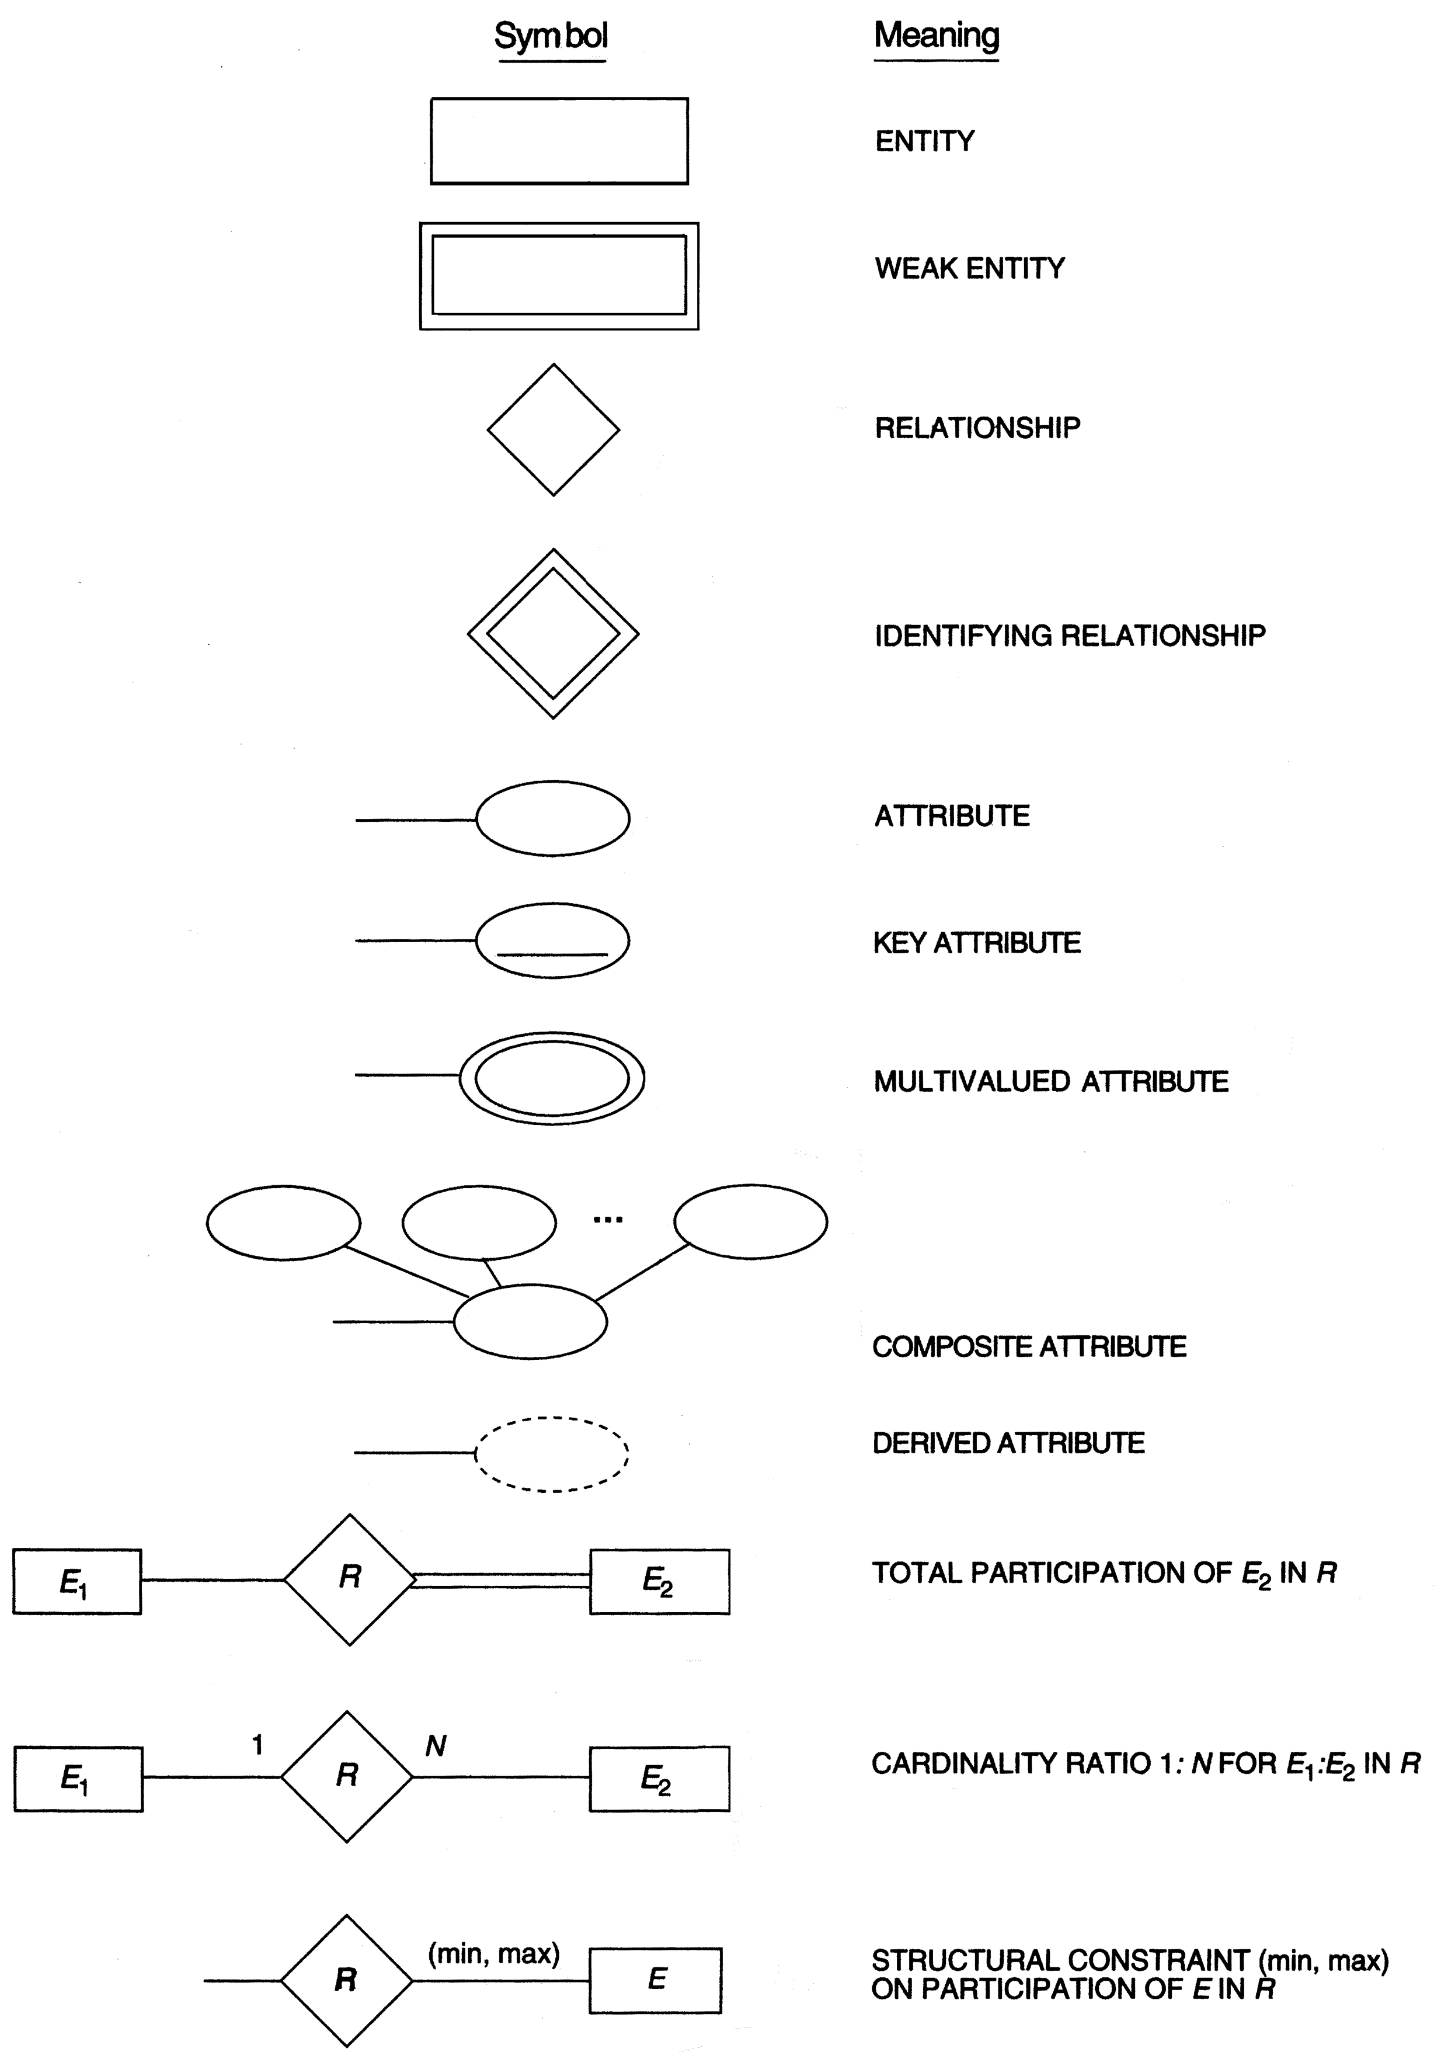
FIGURE 3.14
Summary of the notation for ER diagrams.

Slide 17
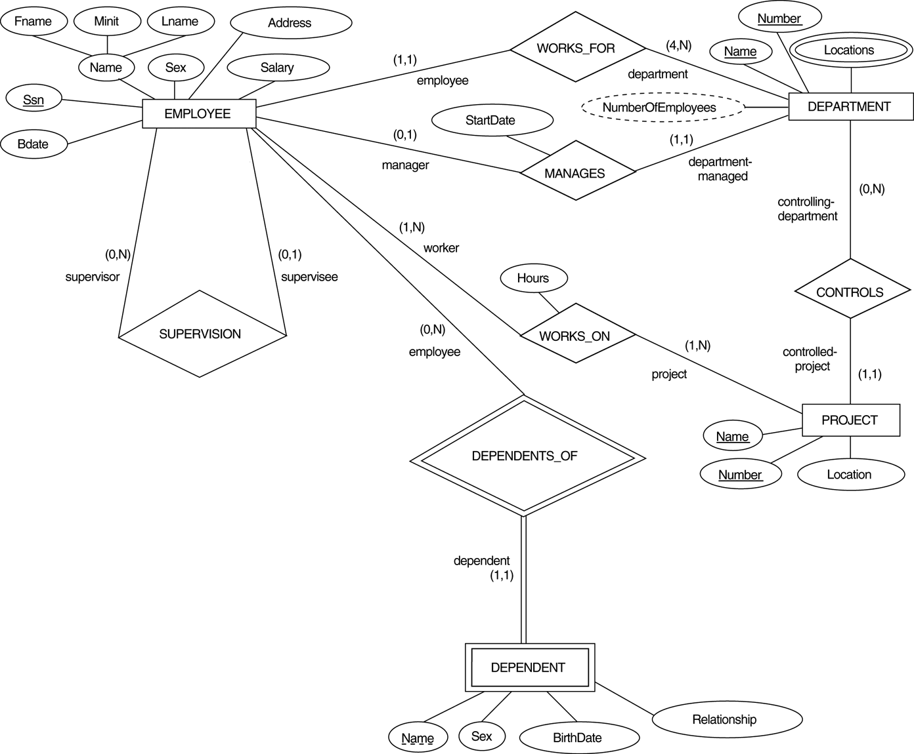
FIGURE 3.15
ER diagrams for the COMPANY schema, with structural constraints specific using (min, max) notation.

Slide 18
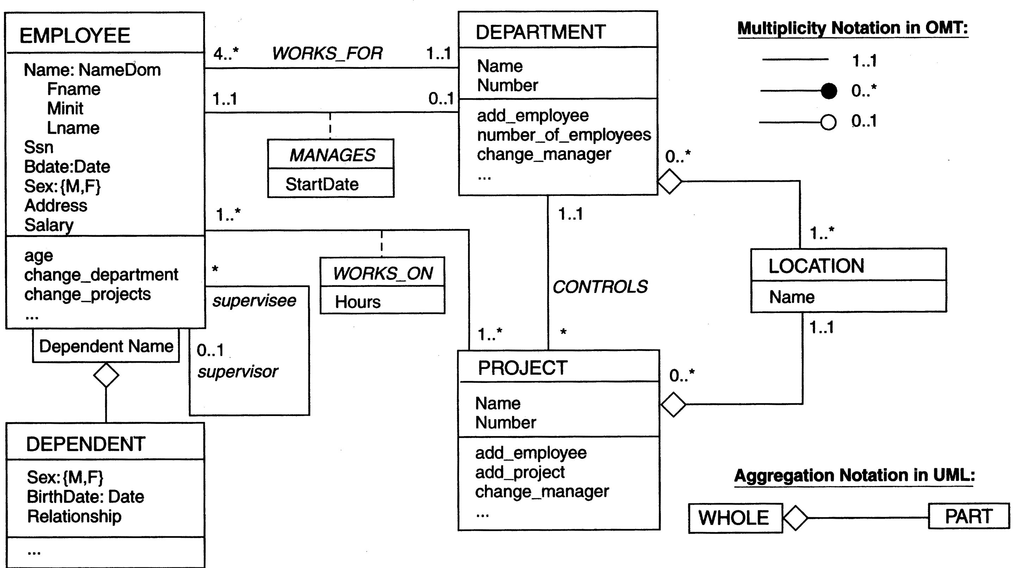
FIGURE 3.16
The COMPANY conceptual scheme in UML class diagram notation.

Slide 19
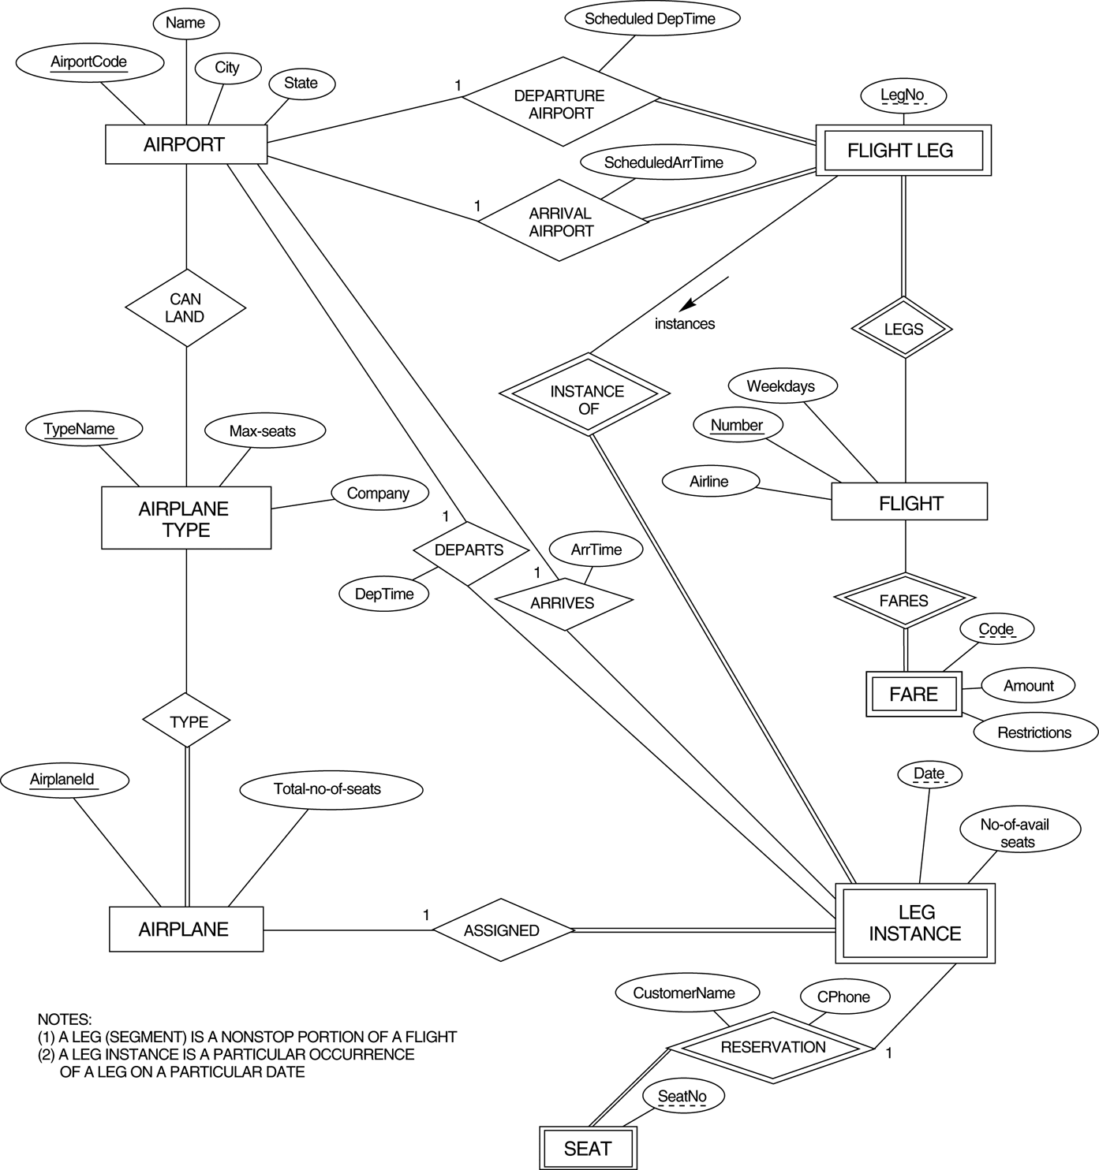
FIGURE 3.17
An ER diagram for an AIRLINE database schema.

Slide 20
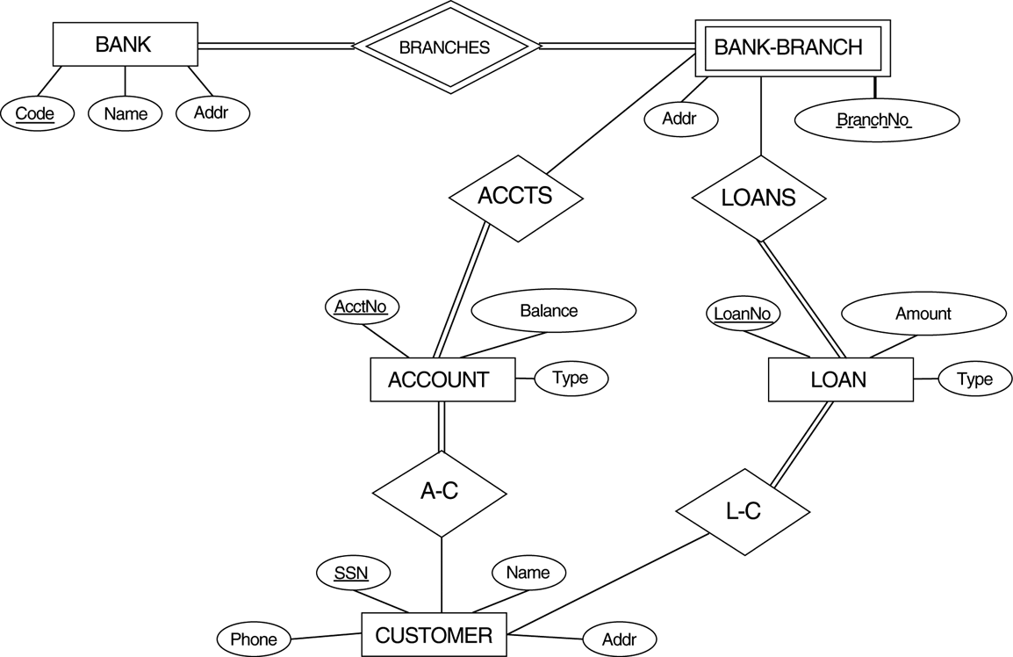
FIGURE 3.18
An ER diagram for a BANK database schema.

Slide 21
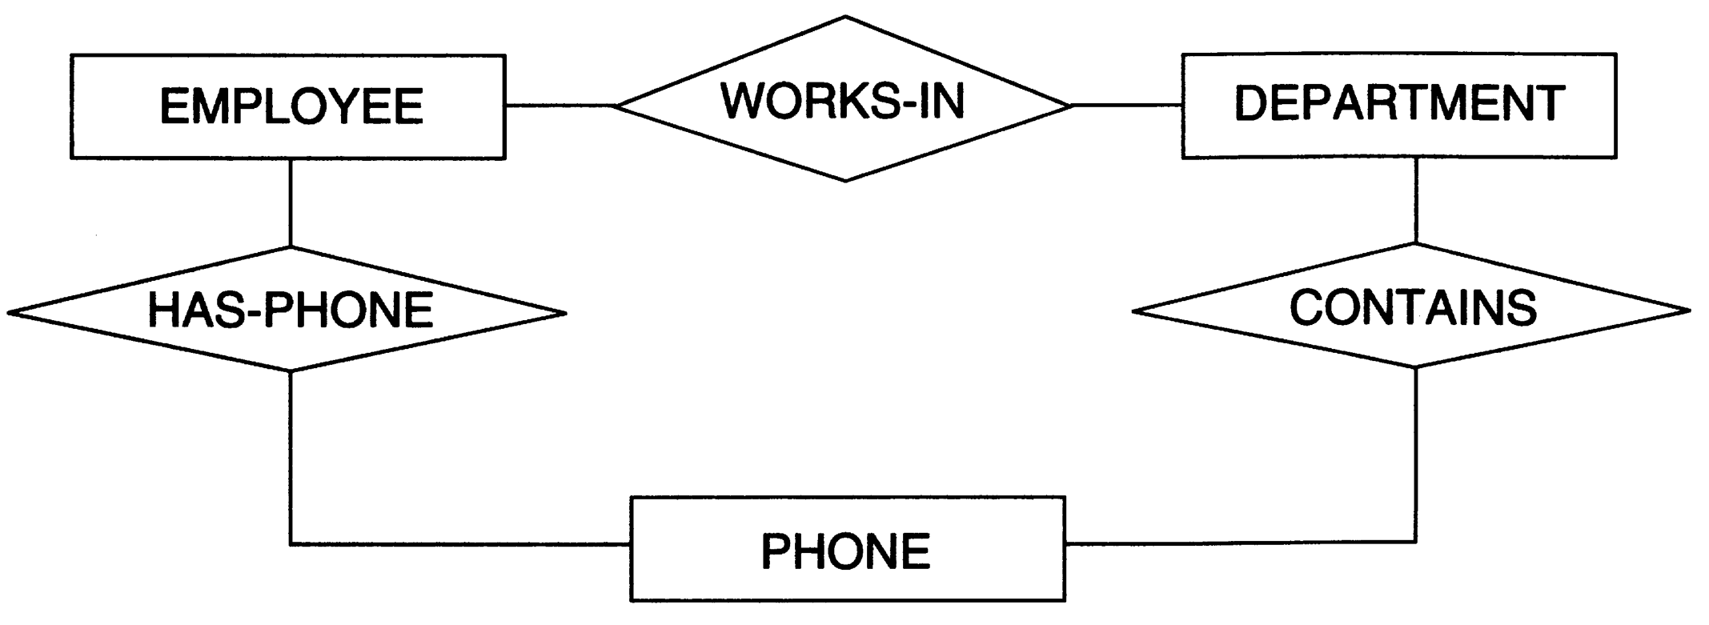
FIGURE 3.19
Part of an ER diagram for a COMPANY database.

Slide 22
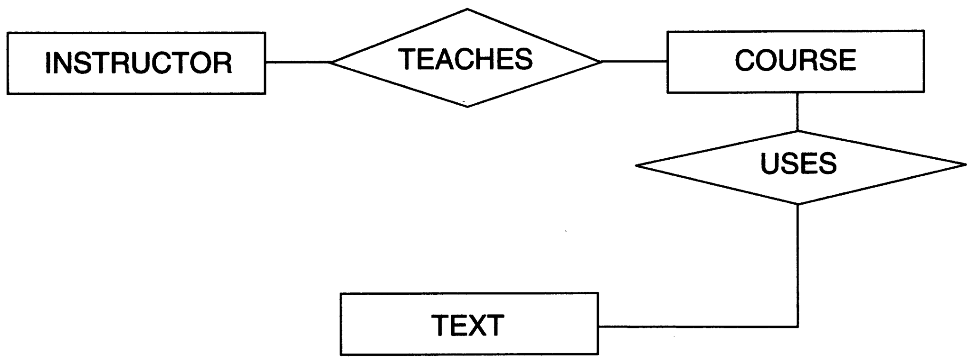
FIGURE 3.20
Part of an ER diagram for a COURSES database.

